Slide 1
Credit Card Fraud Detection (Fraud Shield AI)
Shruthi Prasad – 8/29/2026

Slide 2
Problem Statement & Overview
Fraud is growing with digital transactions and advanced tactics.
Traditional rules miss new fraud patterns
  We use machine learning and deep learning for better fraud detection.
The goal of this project is to build a scalable fraud detection system that finds known and emerging fraud while reducing false positives and improving financial security.
Building a Smarter Defense Against Financial Fraud
Detect Fraud Pattern
Reduce False Positives
Strengthen Financial Security & Trust
Dataset Overview
Key Features
Source: Kaggle – Credit Card Transaction Fraud Detection
Transaction: Date/Time, amount, category
Merchant: Merchant Name and Geographic coordinates
Dataset Size: ~1.3 million Credit Card Transactions
Cardholder: Card number, location, city population
Target: Fraud indicator (is_fraud: 1 = Fraud,
Is_fraud: 0 = Legitimate)
Nature: Realistic Simulation of Fraudulent and Legitimate transactions
Notes:
Credit card fraud is one of the most common financial crimes in the U.S.
More than 60 million Americans experienced it in the past year, and global losses exceed $33 billion annually.

Slide 3

EXPLORATORY DATA ANALYSIS
Understanding the data to ensure quality and identify key patterns
1. DATA QUALITY
2. CLASS DISTRIBUTION
3. KEY EDA INSIGHTS
1.3 M Transactions
Average Transaction Amount
$70.35
Highly Imbalanced Dataset
Fraud represents only 0.58% of all transactions
0
Missing Transactions
Median Transaction Amount
$47.52
0
Duplicate Records
Data Types Standardized
cc num, Zip (String), DOB (Date Time)
Maximum Transaction Amount
$28,948.90
Class Imbalance will be handled using advanced techniques like SMOTE during model training
Outliers Identified
Transaction Amount & City Population
Fraud Rate
0.58% (7,508 transactions)
Key Finding: Dataset is clean with no missing values or duplicates but highly imbalanced

Slide 4
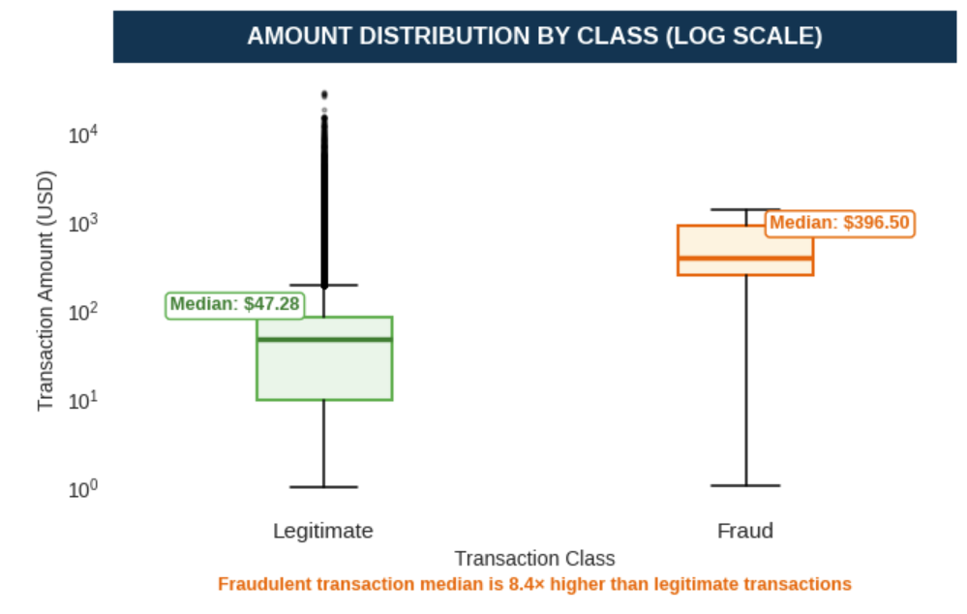
TRANSACTION AMOUNT ANALYSIS
Fraudulent transaction amounts are significantly higher, with a median of $396.50 vs. $47.28 for legitimate transactions—approximately 8.4× higher.
Total Amount (Legit)
$87,234,340.29
AMOUNT STATISTICS BY CLASS
Total Amount (Fraud)
$3,988,088.61
CLASS
MEAN
MEDIAN
STD
MIN
MAX
Legit (0)
$67.67
$47.28
$154.01
$1.00
$28,948.90
Fraud (1)
$531.32
$396.50
$390.56
$1.06
$1376.04
Key Insight: Fraudulent transactions have significantly higher amounts across most summary statistics

Slide 5
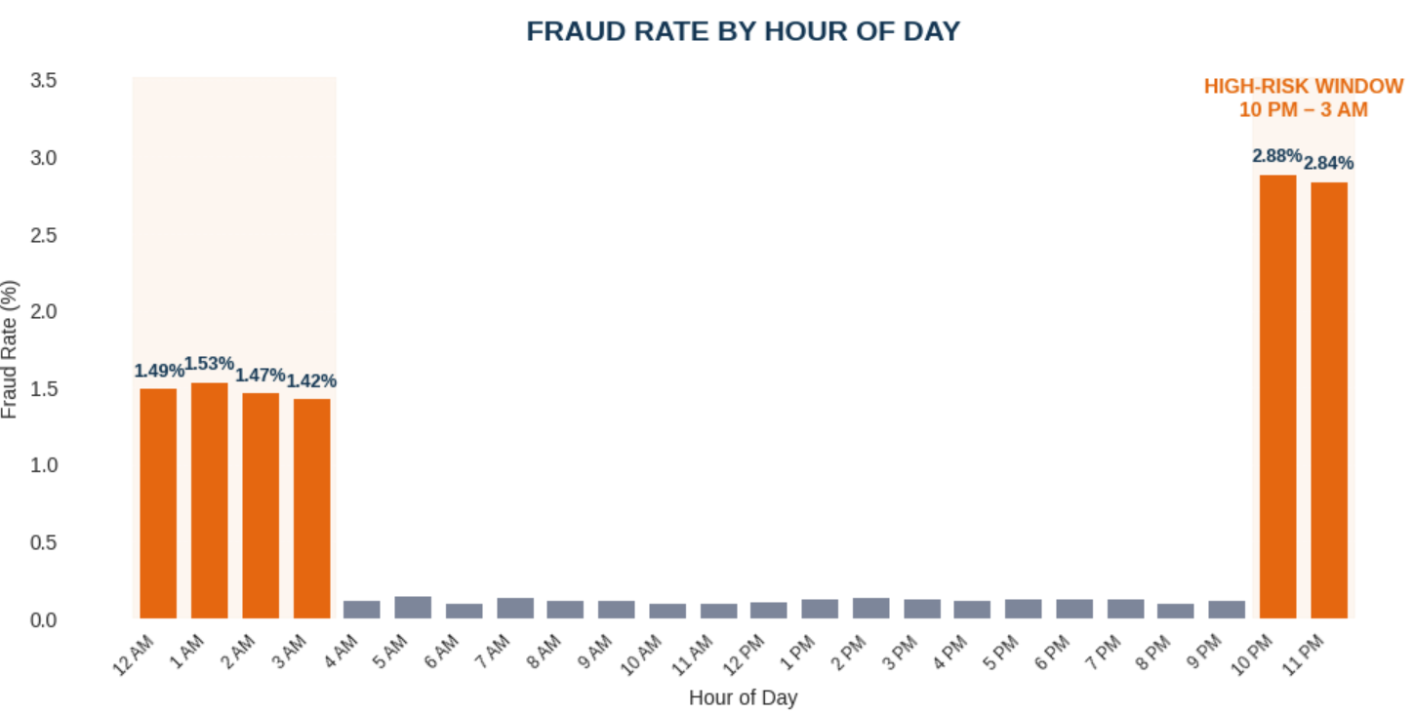
TIME PATTERN ANALYSIS
Fraud is highly concentrated at night, with a 2.087% fraud rate from 10 PM – 3 AM , 18.09X
higher than day time.
NIGHT | 10 PM – 3 AM
304,882
Transactions
2.087%
Fraud Rate
6,362
Fraud cases
18.09X
Higher Fraud Rate
DAY | 4 AM – 9 PM
0.115%
Fraud Rate
991,793
Transactions
PEAK RISK HOURS
10 PM
2.88%
1,931 Fraud Trans
11 PM
2.84%
1,904 Fraud Trans
1,144
Fraud cases

Slide 6
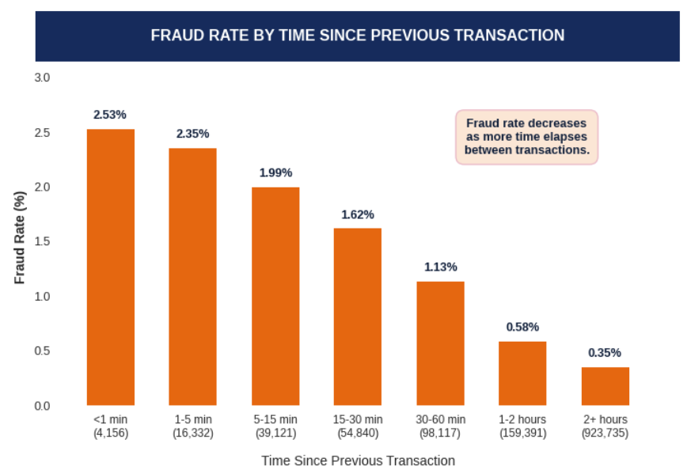
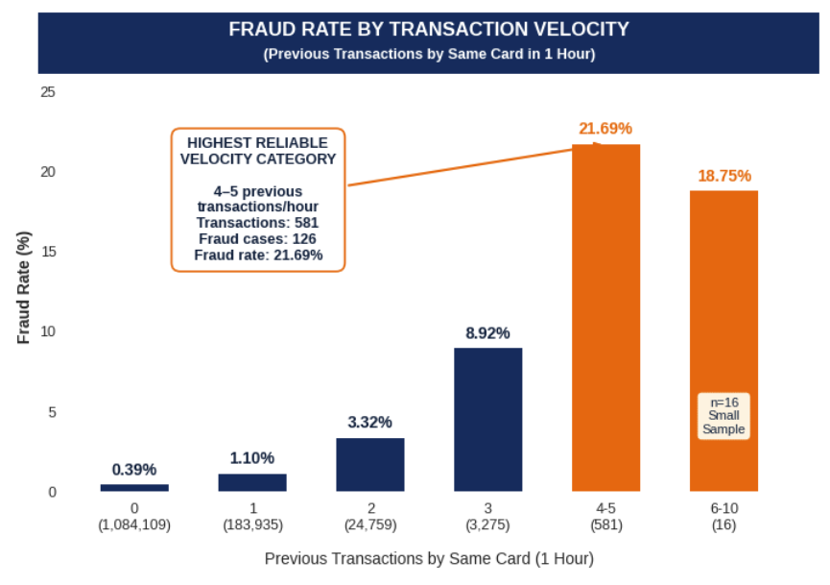
TRANSACTION VELOCITY ANALYSIS
Fraud risk rises sharply with repeated card usage: transactions with 4–5 prior transactions in one hour show a 21.69% fraud rate vs. 0.39% with no prior transactions — a 55.45× increase.
21.69%
HIGH-VELOCITY FRAUD RATE
(4-5 Prior Transaction/hour)
581 transactions | 126 fraud
0.39%
BASELINE FRAUD RATE
(0 Prior Transaction/hour)
1.1 M transactions | 4,240 fraud
55.45 x
RELATIVE RISK INCREASE
(21.69% VS 0.39%)
Higher observed fraud rate

Slide 7
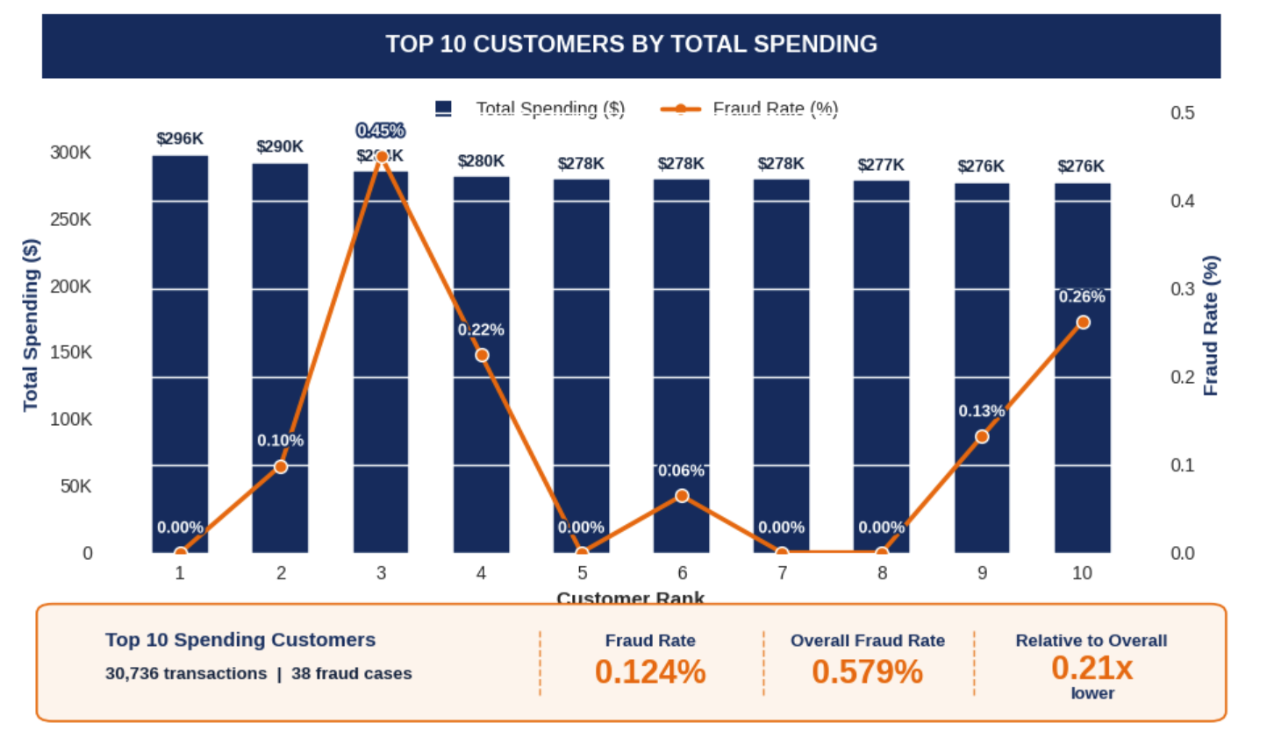
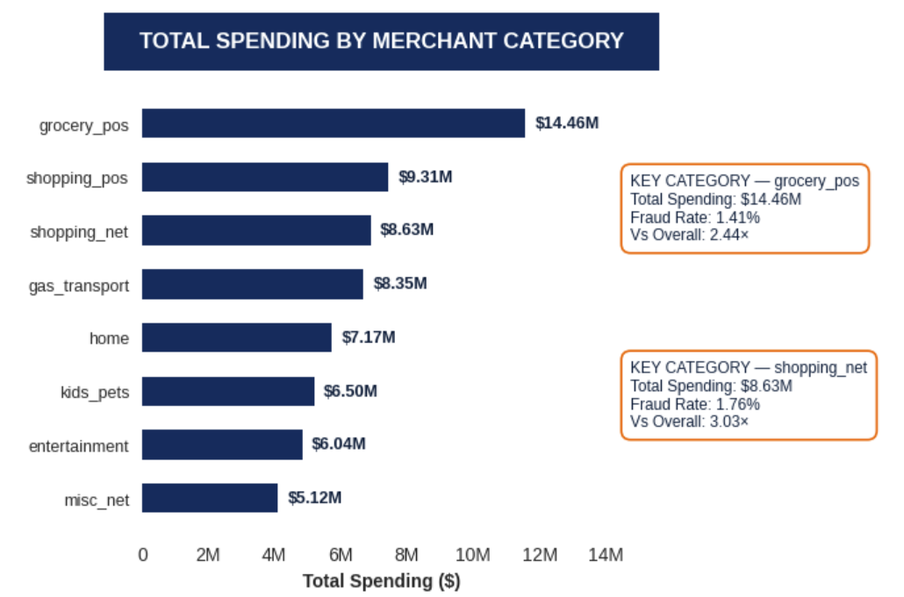
CUSTOMER SPENDING HABIT ANALYSIS
SPENDING CONCENTRATION
27.4% of customers account for 50% of total spending
TOP 10 CUSTOMER FRAUD RATE
0.124%
(vs 0.579% overall fraud rate)
High-spending customers show low fraud risk (0.124%), while 27.4% of customers drive 50% of total spending.
KEY TAKEAWAY: High spending alone is not a strong fraud indicator; top spenders had a 0.124% fraud rate vs. 0.579% overall. Combining customer spending patterns, merchant category, transaction amount, velocity, and timing provides stronger signals for identifying high-risk transactions.

Slide 8
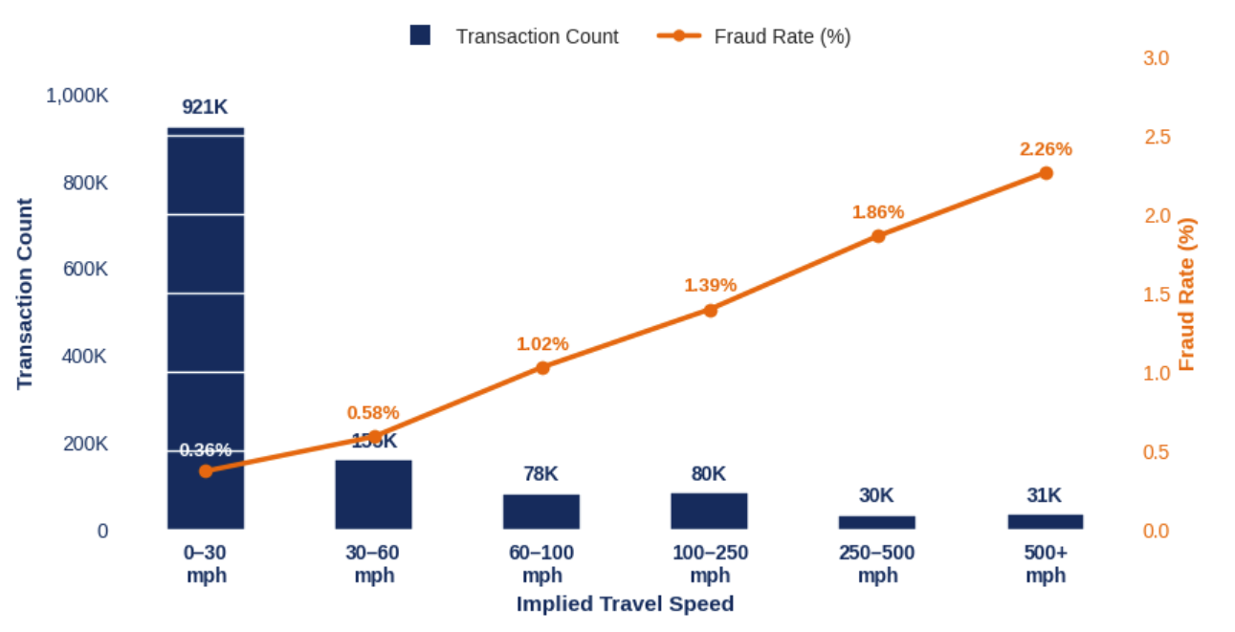
GEO SPATIAL METRIC ANALYSIS
Implied travel speed estimates how fast a cardholder would need to travel between two consecutive transaction locations, based on the distance traveled and time between transactions. Unusually high speeds can indicate geographically impossible or suspicious card activity.
Key Insight: Transactions in the 500+ mph category have a 2.258% fraud rate, ~3.90X the overall fraud rate of 0.579%. This suggests unusually rapid geographic movement between consecutive transactions may be a valuable fraud-detection feature.

Slide 9
EDA INSIGHTS → FEATURE ENGINEERING
The Fraud model should prioritize behavioral and transaction-level features
Rapid repeated transactions on the same card
Late night transactions (10 PM – 3 AM)
Larger than normal transaction amounts
Certain Merchant Categories
Unusually high Implied Travel Speeds between consecutive transactions
High Value Model Features
Amt (Transaction Amount)
Hour Of Day
Category
Transaction Velocity
Minutes & Distance Since Previous Transaction
Implied Travel Speed

Slide 10
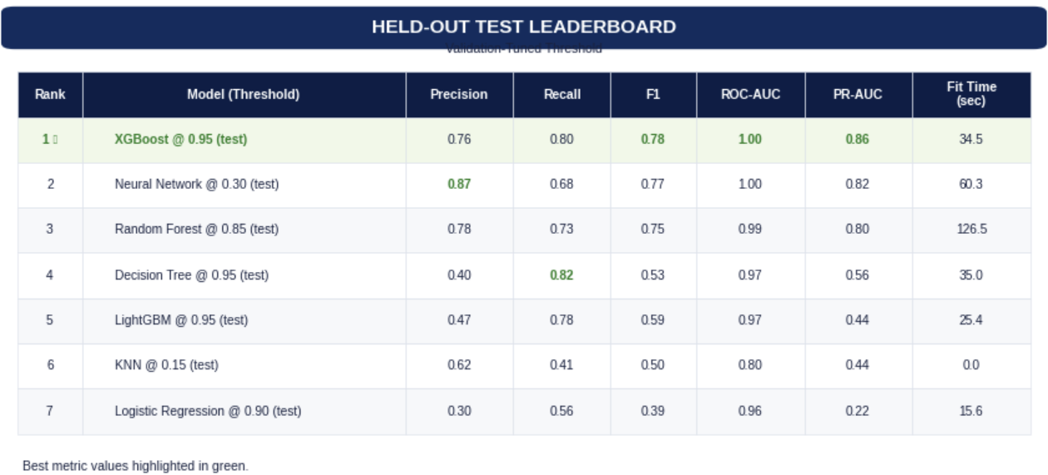
MODEL BUILDING & EVALUATION
Comparing multiple machine learning models to find the best fraud detection system
Goal:
Identify the model with the best balance of high recall and low false positives
Dataset:
~ 1.3M transactions
Fraud Rate : ~0.58%
Evaluation:
Test set with validation tuned threshold
Metric:
Recall, F1-Score, Precision, PR-AUC
1
Baseline Models:
Logistic Regression, Decision Tree, KNN
2
Ensemble Models:
Random Forest
3
Boosting Models:
XGBoost, LightGBM
4
Neural Network:
Threshold Tuning:
Optimize threshold on validation set and evaluate on test set
5
Final Model Selection : XG Boost delivers the best overall balance with 80% recall and 76% precision

Slide 11
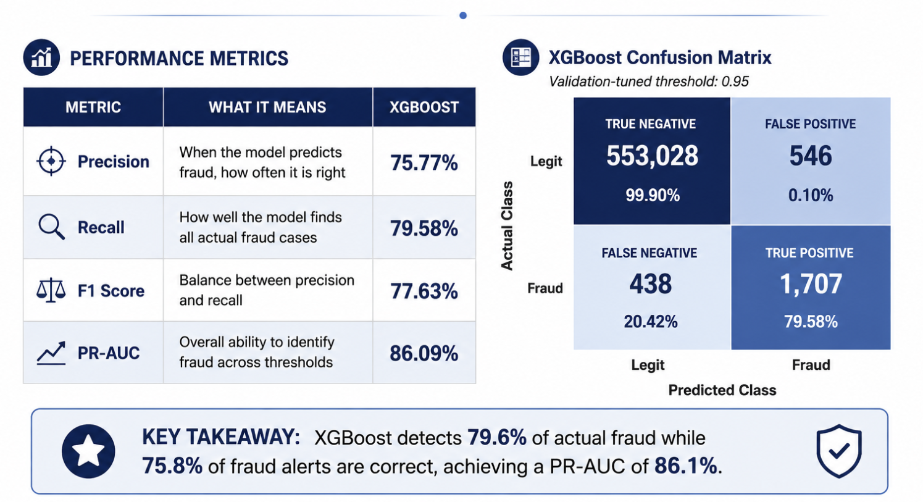
XG Boost Model

Slide 12
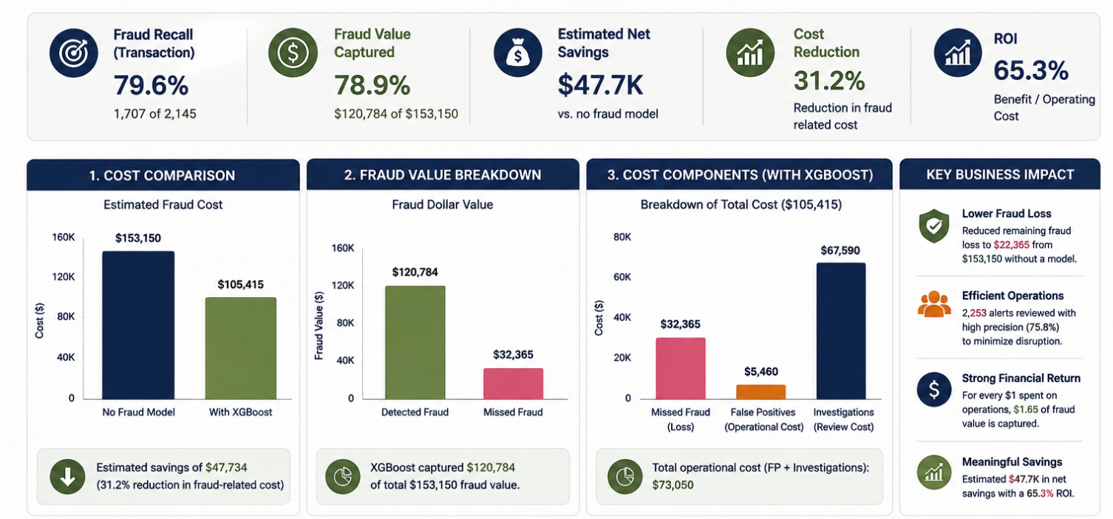
Recommendation
Cost – Benefit Summary : XG Boost detected 79.6% of fraud transactions and captured 78.9% of fraud value ($120,784 of $153,150), reducing estimated fraud-related cost by 31.2% and delivering $47.7K in net savings at a 65.3% ROI.

Slide 13
THANK YOU
QUESTIONS?

Slide 14
Recommendation
Cost – Benefit Summary : XG Boost detected 79.6% of fraud transactions and captured 78.9% of fraud value ($120,784 of $153,150), reducing estimated fraud-related cost by 31.2% and delivering $47.7K in net savings at a 65.3% ROI.

Slide 15
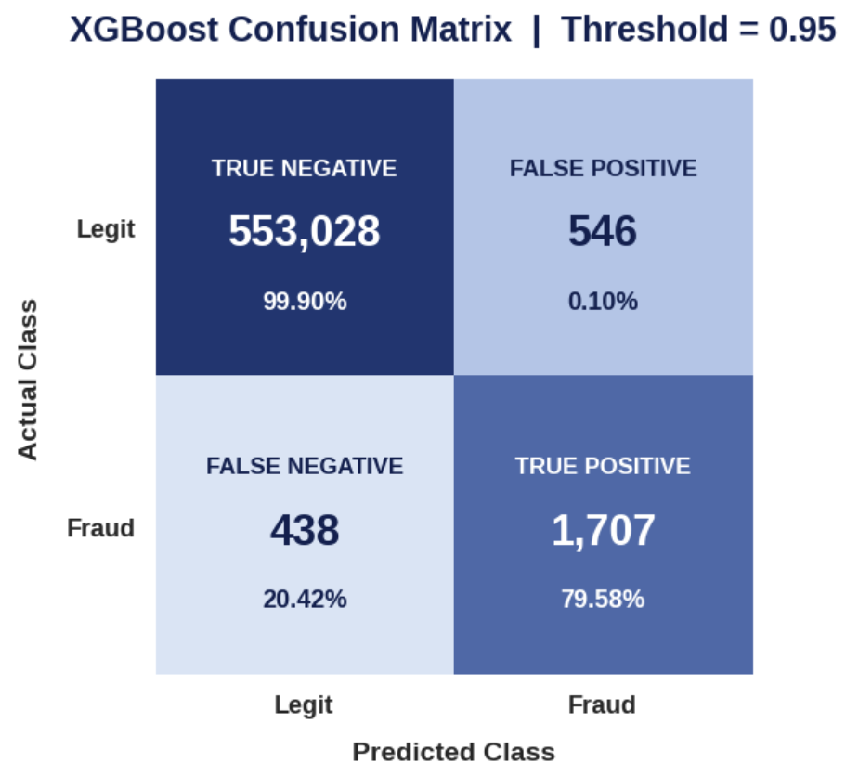
XG Boost Model
Model Performance
METRIC | WHAT IT MEANS | XGBOOST
Precision | When the model predicts fraud, how often it is right | 75.77%
Recall | How well the model finds all actual fraud cases | 79.58%
F1 Score | Balance between precision and recall | 77.63%
PR-AUC | Overall ability to identify fraud across thresholds | 86.09%

